Slide 1
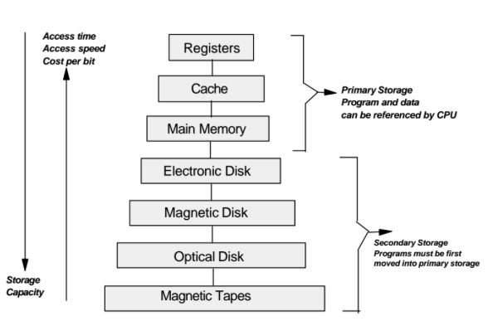
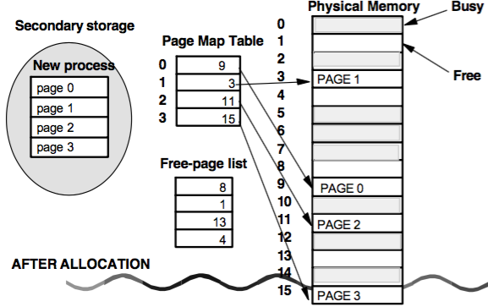
Lecture 6 Virtual Memory Organization Virtual Address Translation, Paging
Borko Furht Florida Atlantic University

Slide 2
Storage Device Hierarchy

Slide 3
Major Steps in Designing a Memory Manager
1. Adopt a memory (storage) organization.
2. Select a memory management strategy to obtain optimal performance.
Memory organization: the manner in which the main memory is viewed.
Memory management: when and where to place a new program in the memory.
Two basic strategies:
(a) Do we place programs as tightly as possible into available memory to minimize space?
(b) Do we place programs as quickly as possible to minimize execution time?

Slide 4
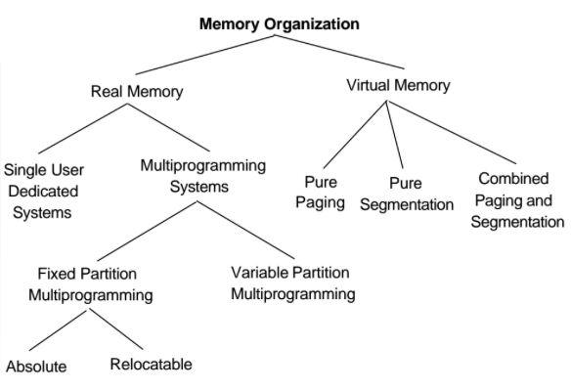
Classification of Memory Organizations

Slide 5
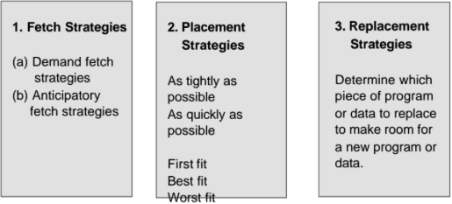
Memory Management Strategies
Goal: best possible use of the main memory resource

Slide 6
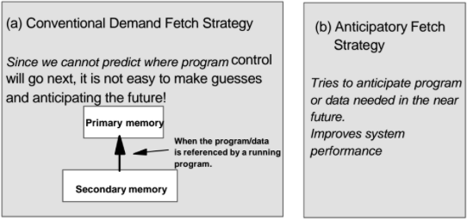
Fetch Strategies
When to obtain the next piece of program or data to insert into main memory.

Slide 7
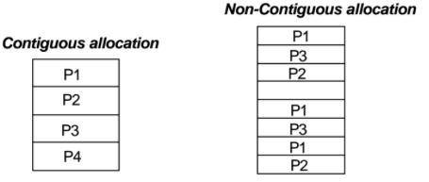
Memory Allocations
Contiguous allocation – each program occupies a single contiguous block of memory.
Non-contiguous allocation – a program is divided into several blocks (segments), that may be placed throughout main memory in pieces.

Slide 8
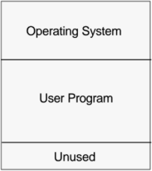
Single User Contiguous Memory Allocation
Earliest computers.
Size of programs are limited to the size of main memory.

Slide 9
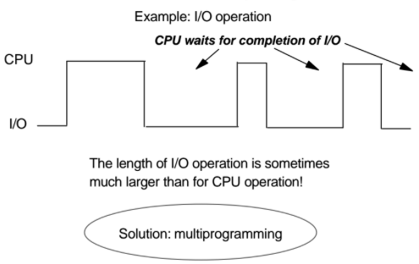
Drawbacks of Single User Systems
Single user systems waste a considerable amount of time of the computing resources.

Slide 10
Multiprogramming Concept
Several users simultaneously use system resources.
It increases (a)CPU utilization and (b) system throughput.
Several jobs must be in the main memory at the same time.
The OS switches control from one to another job.
It requires more primary (main) memory.

Slide 11
Virtual Memory Organization
Ability to address storage space much larger than available in the primary memory.
First VM in Atlas computer at University of Manchester, 1960.
Implementations: paging, segmentation, and combined paging/segmentation systems.

Slide 12
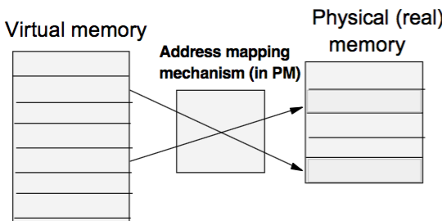
Basic Concept
Disassociate the addresses referenced in a running process from the addresses available in primary memory.

Slide 13
Advantages of Virtual Memory
Easy for software design: the user writes programs considering algorithms and data structures, but ignoring details of the HW structure and real addresses.
Each process may have a virtual address space larger than physical (real) memory.
Small portion of each program may be in real memory.
Uses tow-level memory system: primary and secondary memory.

Slide 14
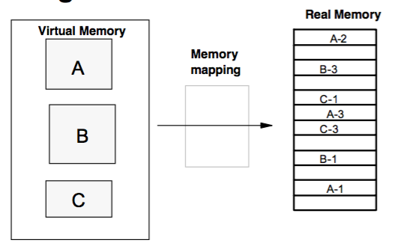
Example of Multiple Programs

Slide 15
Block Mapping
Physical memory is broken into blocks (or frames).
Virtual (logical) memory is also broken into blocks of same sizes.
OS keeps track where in real memory the various virtual memory blocks have been placed.
Blocks: pages (same size)
Blocks: segments (different sizes)

Slide 16
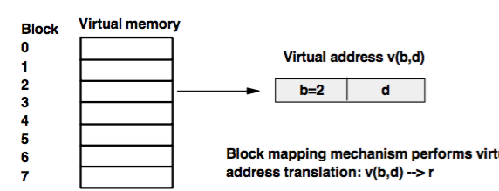
Virtual Address
Consists of the block number (b) and the displacement (d).
Displacement of the item from the start of the block.

Slide 17
Paging
Blocks are of fixed size – pages.
Virtual address v(p,d)
The page number is used as an index into the page map table.
The page map table (PMT) contains an entry for every page in the virtual memory.
The PMT contains the base address of each page in physical memory p’ (page number in physical memory)

Slide 18
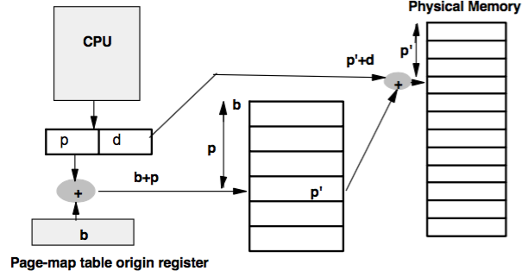
Virtual Address Translation

Slide 19
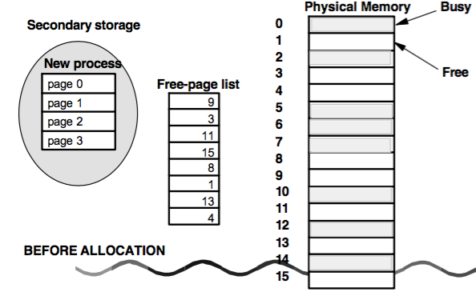
Example of Memory Allocation in Paging System

Slide 20
Example of Memory Allocation in Paging System

Slide 21
Page Size
Larger page size: smaller fraction of real memory devoted to store mapping information (PMT smaller)
Larger pages: takes longer time to transfer from secondary to primary memory and consume more real memory, limiting the number of processes.
Typical page sizes: 512-8192 bytes.

Slide 22
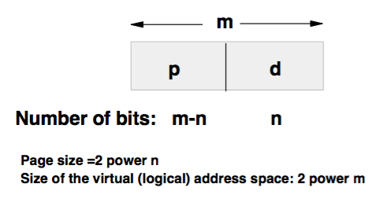
Virtual Address v(p,d)

Slide 23
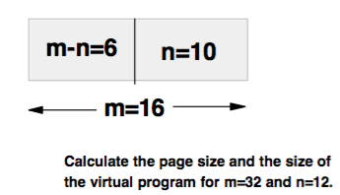
Example
Page size = 1K bytes → n = 10bits
Virtual program: 64K bytes → m=16 bits

Slide 24
Start
Flow Chart of Paging Systems
Direct Mapping
Memory reference
v(p,d)
Entry into PMT b+p
No
Fetch the page from SM
Page in PM?
V=1
Yes
Yes
Page Replacement Algorithm
PM Full?
Find address in PS f=p’d
No
Find address in PS f=p’d
Place the page in PM
Update PMT v and p’
End

Slide 25
Paging Address Translation Techniques
PMT in dedicated registers
PMT in main memory
Combined – main memory and cache (TLB)

Slide 26
Paging Address Translation Techniques
Simplest case: PMT is implemented as a set of dedicated registers.
Example: DEC PDP-11
Page size: 8K (n=13), address=16 bits (m=16)
The PMT has only 8 entries (m-n=3)
This technique is satisfactory, if the PMT size is small (<= 256 entries)
Otherwise, the solution is too expensive.

Slide 27
The PMT in the Main Memory
Contemporary computers: millions of PMT entries.
PMT is in the main memory and a PMT base register (PTBR) points to the PMT.
Main problem: this scheme requires 2 memory accesses to access a user memory location.
First access to PMT in memory and second access to the location to physical memory.
Memory access is slowed by factor 2.

Slide 28
Combined PMT: main memory + fast lookup hardware cache
Fast lookup cache is called associative registers or translation look-aside buffers (TLBs)
Each register consists of two parts: (key, value)
If the key is found, the corresponding value in field is output.
The search is fast.
The hardware is expensive – the number of entries in a TLB is between 8-2048.

Slide 29
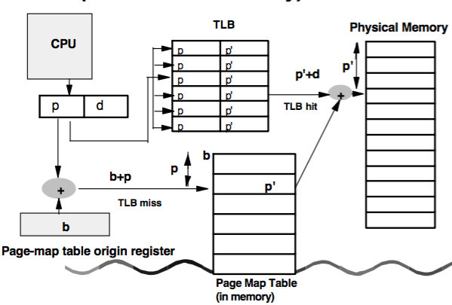
Virtual Address Translation Using TLB (Associative Memory)

Slide 30
Using TLB-Based Mapping
Logical address, generated by the CPU, is first presented to associative registers (TLB).
If the page number (p) is found in the TLB, its frame number in PM (p’) is immediately available and it is used to access the memory.
If the page number is not found in TLB, a memory reference to PMT must be made.
In addition, we add this entry to the TLB for the next reference.

Slide 31
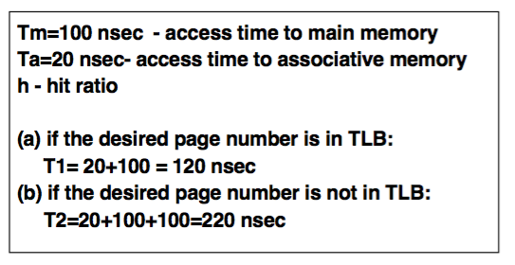
Hit Ratio
The percentage of time a page number is found in the associative registers (TLB).

Slide 32
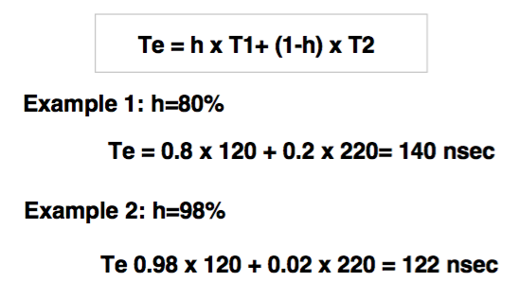
Effective Access Time

Slide 33
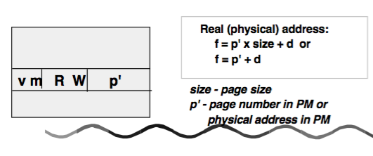
Page Map Table Entry
Whether or not the referenced page is in the primary memory – valid (v) bit.
If it is in PM, where it is (p’)
Whether the page was modified (m bit)
Protection bits: Read, Write, etc.

Slide 34
Multilevel Paging
Modern compute systems support a very large logical (virtual) address space (2 power 32 or 2 power 64)
The PMT itself becomes very large.
If the page size = 4KB (2 power 12), then a page map table may consists up to 1 million entries (2 to 32/2 to 12=2 to 20).
Each process entry consists of 4 bytes – total 4 MB of physical memory for the PMT!
This space should be allocated contiguously in memory.

Slide 35
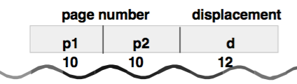
Two-Level Paging Scheme
The PMT is also paged.
Example: 32 bits virtual address is divided to 20 bits page number + 12 bits displacement (4KB page size).
20 bits page number is further divided into 10 bits page number and 10 bits page displacement.
PMTs can be then swapped out to disk when necessary.

Slide 36
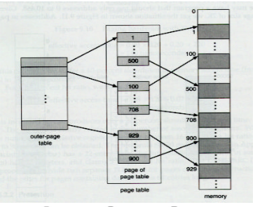
Two-Level Page-Map-Table Scheme

Slide 37
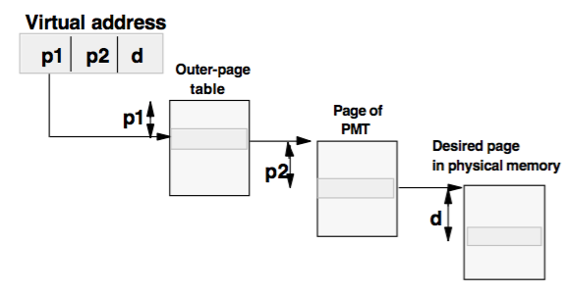
Address Translation in a Two-Level Paging System

Slide 38
Multilevel Paging Systems
For 64-bit logical (virtual) address space, two-level paging scheme is no longer appropriate.
Solution: three-level, and four-level paging scheme.
Example: SUN Sparc architecture supports three-level paging.
Motorola 68030 supports four-level paging.

Slide 39
Sharing in Paging Systems
In timesharing multi-user systems, many users execute the same programs.
These pages can be shared.
Sharing reduces the amount of primary memory needed for a group of processes.
Sharing must be controlled to prevent one process to modify data that another process is reading.
Solution: reentrant, non-modifiable procedures, and modifiable procedures.

Slide 40
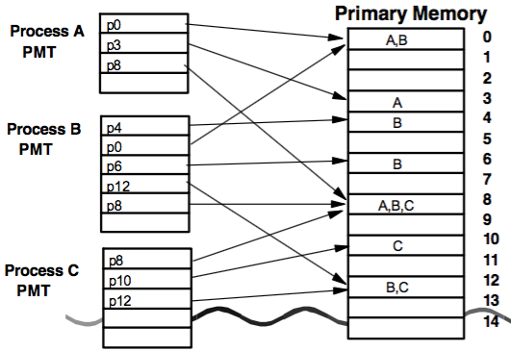
Sharing in a Paging System Example

Slide 41
Case Study: Windows NT Virtual Memory
Page-based memory management.
Page size: 4KB
Address=32 bits (m=32) → 2 power 32 = 4GB virtual space.
Upper 2GB is identical for all processes – used by NT in kernel mode.
Lower 2GB is distinct for every process and is accessible by both user- and kernel-mode threads.

Slide 42
Virtual Memory Characteristics of Windows NT
Each process has a page directory that contains 1024 page-directories of size 4 bytes (1024 different processes).
Each page-directory entry points to PMT that contains 1024 PMT entries of size 4 bytes.
Each PMT entry points to 4KB page in physical memory.
The total size of all the page tables for a process is : 1,024 x 1,024 x 4 B = 4MB.
The VM manager will swap out these tables to disk when necessary.

Slide 43
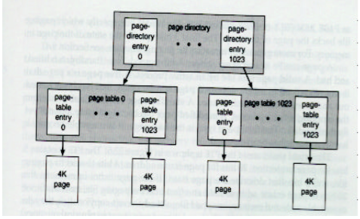
Windows NT Virtual Memory Scheme

Slide 44

Virtual Address Translation in Windows NT
Two-level scheme
10 bits to select an entry in the page directory to point to a PMT.
10 bits to select a PMT entry.
12 bits is displacement to point a specific byte in that page frame.

Slide 45
Page-Map-Table Entry in Windows NT
20 bits to point to physical memory:
Physical address: 20 (p’)+12(d)=32(f)
12 remaining bits to describe the page.
5 bits for protection (R, R/W, etc.)
4 bits describe which paging file backs the page in memory
3 bits – the state of the page in memory.

Slide 46
VM Systems - Summary
Two issues are addressed in VM systems: (a) performance issue (due to two accesses to main memory), (b) memory issues (due to large PMTs)
Performance: by using combined small associative memory (TLB) + PMTs in PM
Large PMT: multi-level tables and using table swapping from/to the disk

